Slide 1

QBUS3350: Project Planning and Management
Contract Management for Project Outsourcing
Taught by
Dr. Erick Li
Discipline of Business Analytics

Slide 2
Lecture Outline
Principal-agent models for project management
Moral hazard
Adverse selection (screening and signaling)
Commonly used contracts for project outsourcing
Fixed Price (FP) and Cost Plus (CP)
Fixed Time (FT) and Time-Based Bonus
Auction
Scoring rule for auctions (one-dimensional to multi-dimensional)
Contract management process

Slide 3
1. Principal-Agent Models for Project Management
History of Principal-Agent Models
The principal-agent literature can be categorized into two subcategories: moral hazard (unobservable action) and adverse selection (hidden information).
Early contributions to moral hazard include: Spence and Zeckhauser (1971), Ross (1973), Stiglitz (1975), and Mirrlees (1975, 1999).
Early contributions to adverse selection include: Mirrlees (1971), Mussa and Rosen (1978), Baron and Myerson (1982), and Maskin and Riley (1984).
References:
Bolton, P. and M. Dewatripont. 2005, Contract Theory, The MIT Press, Cambridge, USA. (Chapters 2 and 4)
Holmstrong, B. 2017, Pay for performance and beyond, American Economics Review, 107(7): 1753-1777.
Notes:
Conceptual

Slide 4
1. Principal-Agent Models for Project Management
A Canonical Moral Hazard Model
The agent provides a service to the principal and the main issue is how to motivate the agent to work diligently.
Many business problems (including project management) have similar characteristics.
Identify principal and agent in following pairs:
Shareholders and CEO;
Customers and insurance company;
Farmers and landlords;
Retailer and manufacturer; (unclear, depending on who possesses the pricing power!)
Salesperson and marketing manager;
Transportation authority and construction companies.

Slide 5
1. Principal-Agent Models for Project Management
Typical Examples
Shareholders and CEO;
Shareholders award the CEO based on profit after tax. However, shareholders cannot constantly spy on the CEO who may shirk. When the corporate profit is strong, does it always mean that the CEO works diligently and deserves all the credit?
Additional reading: Edmans A, Gabaix X, Jenter D. 2017. Executive Compensation: A Survey of Theory and Evidence. In: Handbook of the Economics of Corporate Governance, Chapter 9; pp. 383-539.
Farmers and landlords;
Landlords cannot constantly spy on the famers. When the yield is low due to weather reason, can landlords blame the famers? When the yield is high, is it solely because of the farmer’s hard work? Yield is a noisy signal of the famer’s effort.
Additional reading: Stiglitz, J. (1974). "Incentives and Risk Sharing in Share Cropping". Review of Economic Studies. 41: 219–255.

Slide 6
1. Principal-Agent Models for Project Management
A Canonical Moral Hazard Model
Key notations include:
Principal’s utility V and agent’s utility u. (Both V and u are concave, increasing, and differentiable.)
Effort a to be privately chosen by the agent. Cost of effort k(a), which is continuous, convex, and increasing with respect to a.
Output x, which is a random variable, and distribution of x is F(x|a), which is unique and known to all players.
The agent’s reservation value u₀ (for mathematical convenience, it is often scaled to be zero).
Optimal solution of a moral hazard model should prescribe:
w*(x), which is the optimal wage function (remember that it is a function).
a*, which is the optimal effort to be induced by the optimal contract.
Notes:
If the output is x, the agent earns w(x) and the principal keeps x-w(x).

Slide 7
1. Principal-Agent Models for Project Management
A Canonical Moral Hazard Model
Two approaches to solving a moral hazard model:
Indirect approach
Stackelberg game wherein the principal is the first mover who offers a contract w(x) and then the agent determines the best level of effort to exert.
This approach involves a sequential equilibrium or dynamic programming backward induction.
Direct approach
More popular in economics literature. It gives rise to a set of incentive compatibility (IC) constraints that predict how the agent will react to the offered contract. The optimization problem is solved in a single-stage (without any backward induction or sequential analysis).

Slide 8
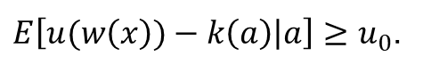
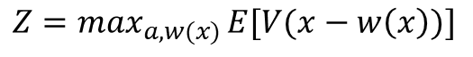
1. Principal-Agent Models for Project Management
A Canonical Moral Hazard Model
To determine the principal’s optimal offer, it is useful to think of that the principal proposes an effort level a along with an incentive reward w(x) such that the agent is happy to choose a, meaning that w(x) is incentive compatible. This leads to the following optimization model (Holmstrom 2017):
subject to:
for any $e≠a$
and
$${Z=max}_{a,w(x)}{E[V(x−w\left(x\right))]}$$
$$E\left[u(w\left(x\right))−k\left(a\right) | a\right]≥E\left[u(w\left(x\right))−k\left(e\right) | e\right],$$
$E\left[u(w\left(x\right))−k\left(a\right) | a\right]≥u_{0}$.
w(x)≥0, ꓯx≥0
Notes:
The principal’s objective function involves two decisions: the induced effort a and the contract w(x).
If we think of w(x) as a decision variable for any given x, then we can write w(x) as w_{x} , where x appears as the subscript. To identify w(x) function, we need to find the values of w_{x} which are infinitely many.
The optimization program that involves i) infinitely many decision variables but finitely many constraints; or ii) finitely many decision variables but infinitely many constraints are called semi-infinite programming (SIP) models.
The infinite programming models usually are not useful because of infinitely many decision variables and constraints.

Slide 9
1. Principal-Agent Models for Project Management
A Canonical Moral Hazard Model
Noteworthy observations
How many incentive compatibility (IC) constraints are there in the model?
Infinitely many. Each pair of (a, e) yields one IC constraint. If we fix a and vary e, there could be infinitely many pairs of them.
If the reservation value u₀ is scaled to be zero, the IR constraint can often be omitted because letting e=0 would yield the IR constraint.
Under direct approach, the agent acts as if he/she does not make any decision but simply follows the principal’s instructions. However, the IC and IR constraints prevent the principal from instructing the agent to undertake some unreasonable actions.

Slide 10
1. Principal-Agent Models for Project Management
First-best Case
We relax the original model by dropping the IC constraint and obtain the so-called first-best solution.
The first-best (FB) solution is an important benchmark because it maximizes the social welfare (which equals the sum of utility).
If the FB solution is feasible to the omitted IC constraint, then we achieve the socially optimum contracting outcome. This may sound too good to be true but actually can happen in a range of circumstances (Holmstrong, 2017).
The output is deterministic.
The agent is risk neutral and has unlimited wealth.
The distribution has a moving support.

Slide 11
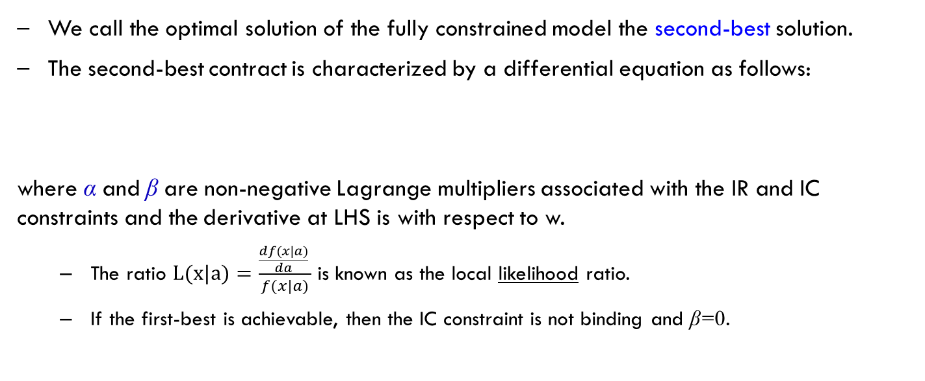
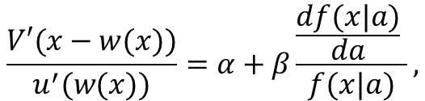
1. Principal-Agent Models for Project Management
Second-best case (Optional)
We call the optimal solution of the fully constrained model the second-best solution.
The second-best contract is characterized by a differential equation as follows:
where α and β are non-negative Lagrange multipliers associated with the IR and IC constraints and the derivative at LHS is with respect to w.
The ratio $L(x|a)=\frac{\frac{df(x|a)}{da} }{f(x|a)}$ is known as the local likelihood ratio.
If the first-best is achievable, then the IC constraint is not binding and β=0.
$$\frac{V′(x−w(x))}{u^{′}(w(x))}=α+β\frac{\frac{df(x|a)}{da} }{f(x|a)},$$

Slide 12
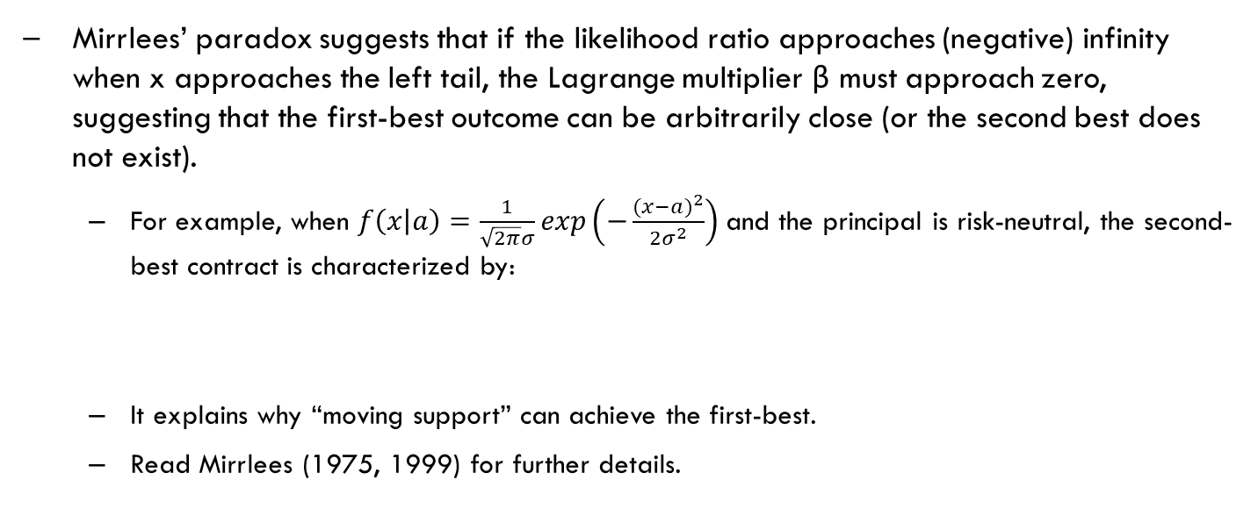
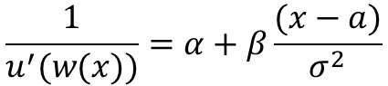
1. Principal-Agent Models for Project Management
Issues related to moral hazard models (Optional)
Mirrlees’ paradox suggests that if the likelihood ratio approaches (negative) infinity when x approaches the left tail, the Lagrange multiplier β must approach zero, suggesting that the first-best outcome can be arbitrarily close (or the second best does not exist).
For example, when $f\left(x | a\right)=\frac{1}{\sqrt{2π}σ}exp\left(−\frac{{(x−a)}^{2}}{2σ^{2}}\right)$and the principal is risk-neutral, the second-best contract is characterized by:
It explains why “moving support” can achieve the first-best.
Read Mirrlees (1975, 1999) for further details.
This differential equation needs to hold for any x. When x approaches negative infinity, the LHS is non-negative and the RHS approaches negative infinity for any positive β. Hence, the only feasible β is zero (suggesting that the IC is not binding or the FB solution is arbitrarily close).
$$\frac{1}{u^{′}(w(x))}=α+β\frac{(x−a)}{σ^{2}}$$

Slide 13
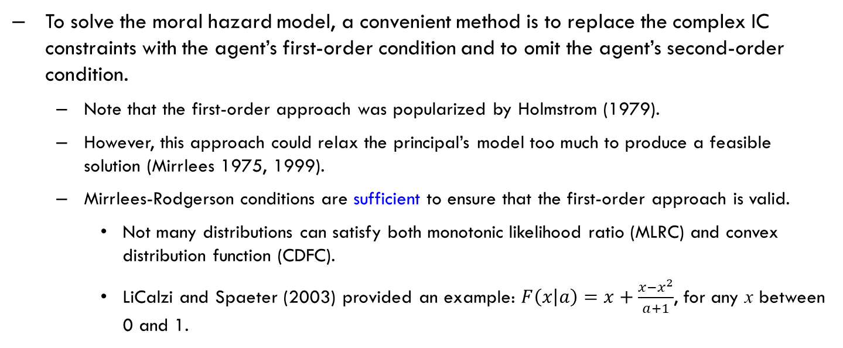
1. Principal-Agent Models for Project Management
Issues related to moral hazard models (Optional)
To solve the moral hazard model, a convenient method is to replace the complex IC constraints with the agent’s first-order condition and to omit the agent’s second-order condition.
Note that the first-order approach was popularized by Holmstrom (1979).
However, this approach could relax the principal’s model too much to produce a feasible solution (Mirrlees 1975, 1999).
Mirrlees-Rodgerson conditions are sufficient to ensure that the first-order approach is valid.
Not many distributions can satisfy both monotonic likelihood ratio (MLRC) and convex distribution function (CDFC).
LiCalzi and Spaeter (2003) provided an example: $F\left(x | a\right)=x+\frac{x−x^{2}}{a+1}$, for any x between 0 and 1.

Slide 14
1. Principal-Agent Models for Project Management
Issues related to moral hazard models
A linear contract (i.e., w(x)=f+bx) is generally sub-optimal.
Instead of identifying a function, we now narrow our analysis to finding the constant f (which represents the base salary) and the slope b (which represents the linear bonus per unit of output).
Linear contracts are commonly used in practice despite the theoretical result that a linear contract is not optimal.
Using a sub-optimal contract is throwing money away.

Slide 15
1. Principal-Agent Models for Project Management
Issues related to moral hazard models
Is there any explanation for this empirical observation (other than simplicity)?
A theoretical puzzle that has not been fully answered.
We focus on linear contracts in this unit due to its simplicity.

Slide 16
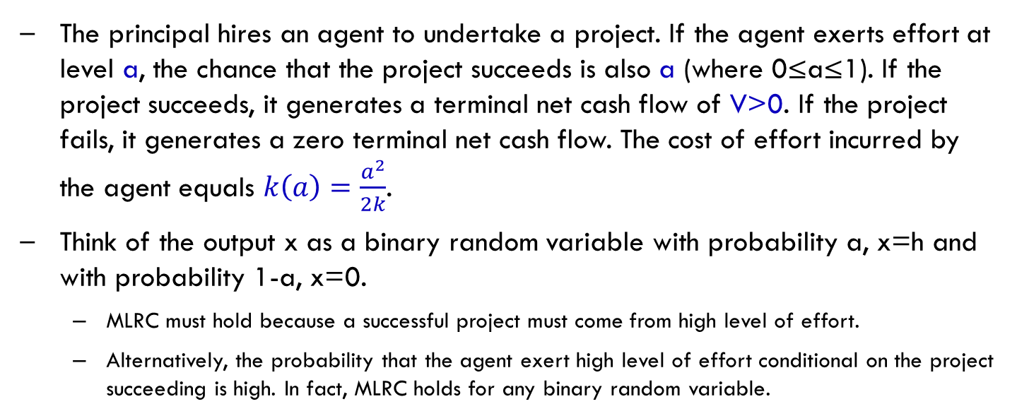
1. Principal-Agent Models for Project Management
Example 1: A binary model
The principal hires an agent to undertake a project. If the agent exerts effort at level a, the chance that the project succeeds is also a (where 0≤a≤1). If the project succeeds, it generates a terminal net cash flow of V>0. If the project fails, it generates a zero terminal net cash flow. The cost of effort incurred by the agent equals $k\left(a\right)=\frac{a^{2}}{2k}$.
Think of the output x as a binary random variable with probability a, x=h and with probability 1-a, x=0.
MLRC must hold because a successful project must come from high level of effort.
Alternatively, the probability that the agent exert high level of effort conditional on the project succeeding is high. In fact, MLRC holds for any binary random variable.
Notes:
Actually, MLRC always holds for binary distribution.

Slide 17
1. Principal-Agent Models for Project Management
Example 1: A binary model
Formulate the principal-agent model using the direct approach.

Slide 18
1. Principal-Agent Models for Project Management
Example 1: A binary model
How do you solve the model that you just formulate?
Using EXCEL
Or Karush–Kuhn–Tucker conditions
Note: For any binary model, the optimal contract can be translated into a linear contract (because two points always lead to a straight line). If the random output has more than 3 realizations, a linear contract is usually sub-optimal.

Slide 19
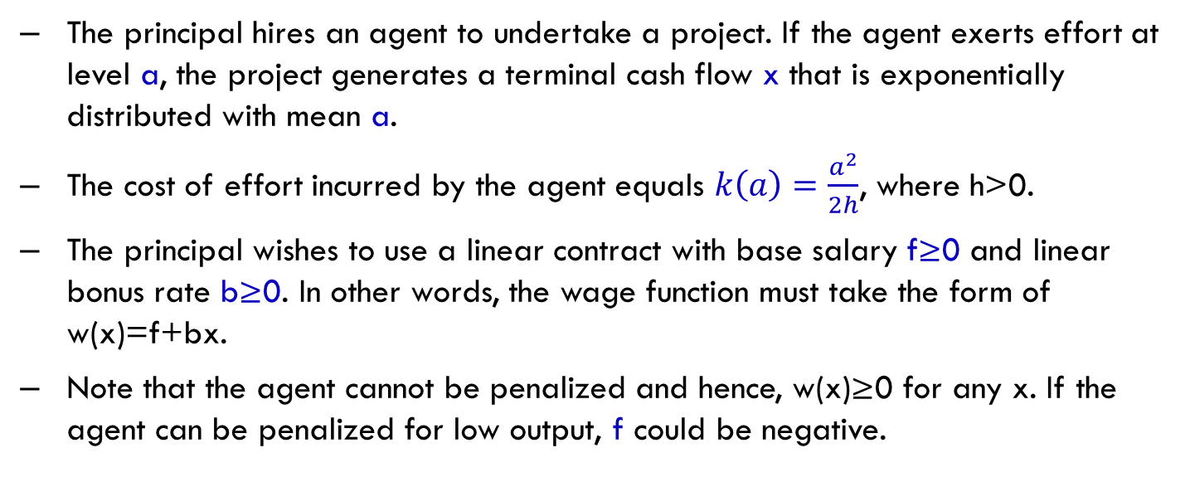
1. Principal-Agent Models for Project Management
Example 2: Linear contract for continuous output
The principal hires an agent to undertake a project. If the agent exerts effort at level a, the project generates a terminal cash flow x that is exponentially distributed with mean a.
The cost of effort incurred by the agent equals $k\left(a\right)=\frac{a^{2}}{2h}$, where h>0.
The principal wishes to use a linear contract with base salary f≥0 and linear bonus rate b≥0. In other words, the wage function must take the form of w(x)=f+bx.
Note that the agent cannot be penalized and hence, w(x)≥0 for any x. If the agent can be penalized for low output, f could be negative.
Notes:
In this unit, we assume both the principal and agents are risk-neutral. Hence, the mean of the output is sufficient (the exact distribution is not crucial unless you wish dive into the issue of moving support, which is not required for this unit).

Slide 20
1. Principal-Agent Models for Project Management
Example 2: Linear contract
Formulate the principal-agent model using the direct approach.

Slide 21
1. Principal-Agent Models for Project Management
Example 2: Linear contract
How do you solve the model that you just formulate?

Slide 22
1. Principal-Agent Models for Project Management
Example 2: Linear contract
What if the reservation value is not zero?
What if the agent can be punished (i.e., w(x) can be negative for some x)?
Is penalty the only device to achieve the first-best outcome?

Slide 23
1. Principal-Agent Models for Project Management
Example 2: Linear contract
What if the reservation value is not zero?
Just change the fixed salary.
What if the agent can be punished (i.e., w(x) can be negative for some x)?
The first-best outcome is achieved.
Is penalty the only device to achieve the first-best outcome?
Change the contract form to a quadratic contract when the output is exponentially distributed and the cost of effort is quadratic.
But what is the downside of a quadratic contract?

Slide 24
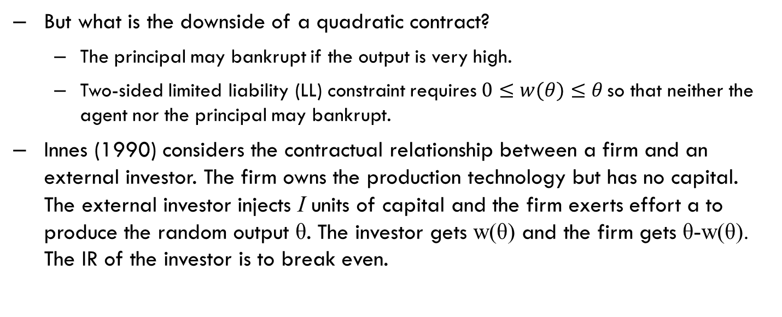
1. Principal-Agent Models for Project Management
Debt contract
But what is the downside of a quadratic contract?
The principal may bankrupt if the output is very high.
Two-sided limited liability (LL) constraint requires$0≤w(θ)≤θ$ so that neither the agent nor the principal may bankrupt.
Innes (1990) considers the contractual relationship between a firm and an external investor. The firm owns the production technology but has no capital. The external investor injects I units of capital and the firm exerts effort a to produce the random output θ. The investor gets w(θ) and the firm gets θ-w(θ). The IR of the investor is to break even.

Slide 25
1. Principal-Agent Models for Project Management
Debt contract
Both the firm and investor are risk neutral and protected by the two-sided LL constraint. Innes (1990) demonstrates that a debt contract is the second-best solution.
Under a debt contract with a loan amount of D, the investor gets w(θ)=min(θ,D) whereas the firm gets max(0,θ-D), where θ is the random output.
Robert D. Innes (1990), Limited liability and incentive contracting with ex-ante action choices, Journal of Economic Theory, 52(1): 45-67.

Slide 26
1. Principal-Agent Models for Project Management
Example 3: Linear contract with finitely many choices of efforts
The contract is restricted to be linear: w(x)=f+bx.
The agent has two choices of efforts: L and H.
If the agent takes effort L, his cost is c_{L}=1 and the output is an exponential distribution with mean 2.
If the agent takes effort H, his cost is c_{H}=1.6 and the output is a uniform distribution with mean 3.
Design a linear contract that induces the agent to take effort H.
The agent cannot be punished so that f and b are non-negative.

Slide 27
1. Principal-Agent Models for Project Management
Example 3: Linear contract with finitely many choices of efforts
With only two choices of efforts, there exists only one pair of IC constraint:
f+b ∙ E(x|H) – c_{H} ≥ f+b ∙ E(x|L) – c_{L}
Substituting the data into the above constraint, we find
f + b∙3 – 1.6 ≥ f+b ∙ 2 –1
The IR constraint is f+b ∙ E(x|H) – c_{H} ≥ 0, which becomes: f+b ∙ 3 – 1.6 ≥ 0
Solving the IC/IR, we find that b=0.6 and f=0. The least-cost linear contract to induce effort H is to pay w(x)=0.6x The principal’s expected profit is Z=E(x|H)-Ew(x|H)=1.2

Slide 28
1. Principal-Agent Models for Project Management
Example 3: Linear contract with finitely many choices of efforts
With only two choices of efforts, there exists only one pair of IC constraint:
f+b ∙ E(x|L) – c_{L} ≥ f+b ∙ E(x|H) – c_{H}.
Substituting the data into the above constraint, we find
f + b∙2 – 1 ≥ f+b ∙ 3 –1.6
The IR constraint is f+b ∙ E(x|L) – c_{L} ≥ 0, which becomes: f+b ∙ 2 – 1 ≥ 0.
Solving the IC/IR, we find that the least-cost linear contract is not unique: w(x)=f+bx such that f+2b=1 and both f and b are non-negative. The principal’s expected profit is Z=E(x|L)-Ew(x|L)=2-1=1
A comparison of the two least-cost linear contract yields that the optimal linear contract is to pay w(x)=0.6x to the agent to induce H and the principal’s expected profit is 1.2

Slide 29
1. Principal-Agent Models for Project Management
Example 4: Verify whether IC holds
Suppose that the agent has two choices of effort: L or H. The details are reported in the following table.
The agent’s reservation value is 3. The current contract is w(x)=2+0.5x. Can it induce effort H from the agent?
Agent’s Option | Agent’s Cost | Output
L | 8 | Exponential with mean 20
H | 16 | Normal with mean 38 and standard deviation 12

Slide 30
1. Principal-Agent Models for Project Management
Example 4: Verify whether IC holds
Let U(L) be the agent’s utility by taking action L and U(H) be the agent’s utility by taking action H.
Under the current contract, U(L)=2+0.5*20-8=4 and U(H)=2+0.5*38-16=5.
Because U(H)>U(L) and U(H)>u₀=3, the current contract induces effort H.
However, is the current contract the least-expensive linear contract to induce effort H?
Notes:
It is useful to review the concept of transformed random variables in BUSS1020 or QBUS5001.
E(f+bx)=f+bE(x), where f and b are constants and x is a random variable with mean E(x).

Slide 31
1. Principal-Agent Models for Project Management
Criticism on Example 4
The agent has only two options to choose and the principal knows these two options.
Carroll (2015) proposed a new model in which the agent has a third option X to choose but the principal knows nothing about option X. This extension gives rise to ambiguity.
The ambiguity creates an infinite programming model (the number of IC constraints grows to infinity because there are infinitely many X). Under a max-min robust decision rule, a linear contract is optimal (Carroll, 2015).
Carroll’s result underscores the importance of using linear contracts when ambiguity exists.
Reference:
Carroll, Gabriel. 2015. "Robustness and Linear Contracts." American Economic Review, 105 (2): 536-63.

Slide 32
1. Principal-Agent Models for Project Management
Extensions of the single-task single-agent model (Optional)
Multiple tasks (Holmstrom and Milgrom 1991)
Key assumptions of HM 1991 include: substitute tasks, normally distributed output, and negative exponential utility.
Complementary tasks (not addressed yet!)
In a two-task model,
If the principal cares only output-1 that is unmeasurable (objective measurement is infeasible only subjective measurement is possible but too political, mathematically, the variance of the normal distribution is infinite), the principal offers no inventive.
If the principal controls only output-1 and the agent sells output-2 to an external market, the principal is either raise the incentive for output-1 or employ the agent to prevent the agent from engaging the external market. (Employment rather than contracting.)

Slide 33
1. Principal-Agent Models for Project Management
Extensions of the single-task single-agent model (Optional)
Dynamic models (an active area of research)
Martingale representation theorem re-formulates the IC constraints as a continuous-time differential equation
Robust decision rules (my recent research area)
Max-min (which replies on less information on distributions)
Agents in teams (not well studied yet but very common in project management)
Multiple principals engage with a single agent (growing area)
Government and shareholders vs CEO or firm
Empirical validation of numerous theories
But details of contracts are confidential, limiting data availability.

Slide 34
1. Principal-Agent Models for Project Management
A Canonical Adverse Selection Model
Key notations include:
The private type of the agent is θ that may represent the production cost per unit of output.
The output q and the payment to the agent P(q).
The agent’s reservation value U₀ (for mathematical convenience, it is often scaled to be zero).
The principal’s utility by consuming q units of output is R(q), which is continuous, concave, and increasing in q.
The distribution of types is F(θ).
The optimal solution of an adverse selection model should prescribe:
P*(q), which is the optimal payment function.

Slide 35
1. Principal-Agent Models for Project Management
A Canonical Adverse Selection Model
Contrasting adverse selection and moral hazard
In adverse selection, the output q is not random but deterministically chosen by the agent.
In other words, a type-θ of agent would choose an output quantity q(θ) and the principal commits to pay P(q(θ)). It is now clear that q and P are both functions of θ.
Adverse selection must give rise to a different set of IC constraints.
q can be interpreted as time reduction in completing the project.
If the type distribution is F(θ|a), meaning that the type depends on effort a, it gives rise to a principal-agent model that combines both moral hazard and adverse selection.

Slide 36
1. Principal-Agent Models for Project Management
A Canonical Adverse Selection Model
Revelation principle: It suffices to focus on direct and incentive compatible mechanisms.
A mechanism includes: P(m) and q(m). If the agent reports m, the output must be q(m) and the payment must be P(m). We deliberately use m not θ when describing the mechanism.
Direct means that the agent’s report space is the same as his type space. (For example, if θ is between 0 and 1, then m must be between 0 and 1.)
Incentive compatible means that in the reporting stage, the agent prefers to truthful revelation of his private type. In equilibrium, sending a message m=θ is optimal for a type-θ agent. (Now, the private type connects to the optimal m=θ.)
Truthful revelation has something to do with prisoner dilemma. Although the principal cannot verify the agent’s report m, the principal knows that the agent is worse off by lying under the optimal mechanism.

Slide 37
1. Principal-Agent Models for Project Management
Extensions of canonical adverse selection model (Optional)
What if the informed agent is the first mover who signals to the uninformed principal?
Spencer (1973) laid the foundation for signalling games.
Separating equilibrium, pooling equilibrium, or counter-signalling equilibrium.
Politicians on certain issues
Expensive office of lawyers
Over-capacity to signal confidence about growth
Counter-signaling equilibrium often requires independent information (word-of-mouth on hotels’ service)
Multiple receivers and a single sender.
The single sender may send different signals through different channels.

Slide 38
1. Principal-Agent Models for Project Management
Extensions of canonical adverse selection model (Optional)
Unravelling effect in accounting disclosure.
The IPO firm knows its true value V and sells 50% of the ownership to the financial market to raise capital. If the firm decides to disclose its true value V, it cannot lie because of accurate audit and harsh penalty for lying. How does the signalling equilibrium look like?
When there are multiple agents, an auction allows each agent to signal and compete.
Auction is closely related to adverse selection.

Slide 39
1. Principal-Agent Models for Project Management
A Binary Example of Adverse Selection
The agent’s type is either L with probability a or H with probability 1-a, where 0<L<H. Type-L agent’s linear cost is L and that of type-H agent is H, where H>L.
The principal’s utility is R(q)=2q-q².
The revealing principle indicates that a feasible mechanism must take the form of:
{P(L), q(L); P(H), q(H)}. There are 4 decision variables.
The principal’s objective is as simple as:
But the IC constraints (which must differ from that in moral hazard) include:

Slide 40
1. Principal-Agent Models for Project Management
A Binary Example of Adverse Selection
How do you solve the model that we just formulate?
Feasible conditions on q.
Optimal information rent for L-type.
Putting everything together, we obtain the virtual surplus.

Slide 41
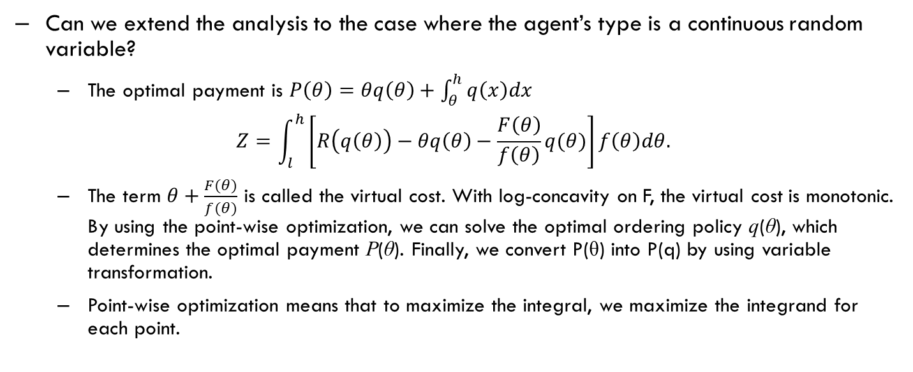
1. Principal-Agent Models for Project Management
A Continuous Example of Adverse Selection (Optional)
Can we extend the analysis to the case where the agent’s type is a continuous random variable?
The optimal payment is $P\left(θ\right)=θq\left(θ\right)+\int_{θ}^{h}{q\left(x\right)dx}$
$$Z=\int_{l}^{h}{\left[R\left(q\left(θ\right)\right)−θq\left(θ\right)−\frac{F\left(θ\right)}{f\left(θ\right)}q(θ)\right]f\left(θ\right)dθ.}$$
The term $θ+\frac{F(θ)}{f(θ)}$ is called the virtual cost. With log-concavity on F, the virtual cost is monotonic. By using the point-wise optimization, we can solve the optimal ordering policy q(θ), which determines the optimal payment P(θ). Finally, we convert P(θ) into P(q) by using variable transformation.
Point-wise optimization means that to maximize the integral, we maximize the integrand for each point.

Slide 42
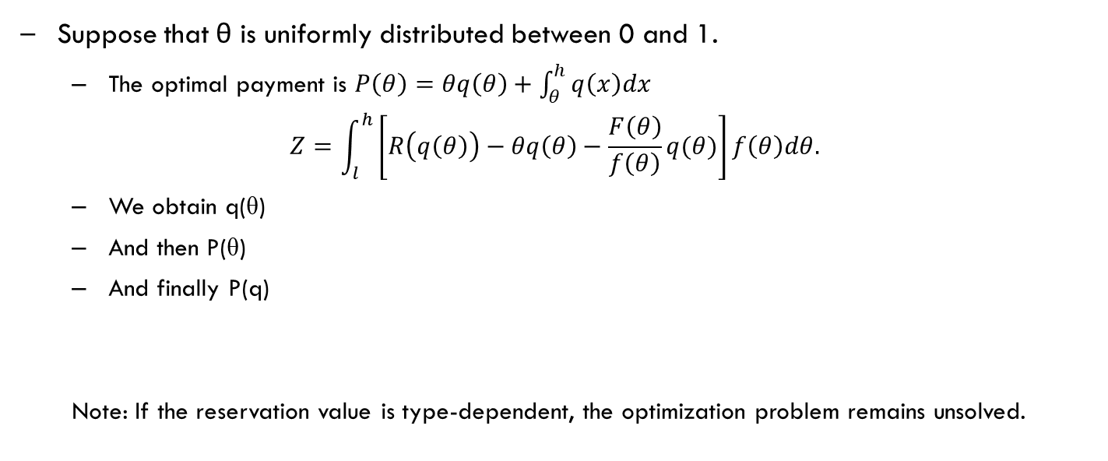
1. Principal-Agent Models for Project Management
A Continuous Example of Adverse Selection (Optional)
Suppose that θ is uniformly distributed between 0 and 1.
The optimal payment is $P\left(θ\right)=θq\left(θ\right)+\int_{θ}^{h}{q\left(x\right)dx}$
$$Z=\int_{l}^{h}{\left[R\left(q\left(θ\right)\right)−θq\left(θ\right)−\frac{F\left(θ\right)}{f\left(θ\right)}q(θ)\right]f\left(θ\right)dθ.}$$
We obtain q(θ)
And then P(θ)
And finally P(q)
Note: If the reservation value is type-dependent, the optimization problem remains unsolved.

Slide 43
1. Principal-Agent Models for Project Management
Auctions
As aforementioned, auction is closely related to adverse selection (or signalling).
Types of auctions:
English auction
Dutch auction
Seal-bid second-price auction
Seal-bid first-price auction
Combinatory auction
…

Slide 44
2. Commonly Used Contracts for Project Management
In many cases, what really matters is the price! But price is a closely guarded secret.
Lockstrom et al. (2011) interviewed the purchasing manager, quality manager, or general manager of sampled companies and found that "there is a great deal of adversarial behaviour where information asymmetry plays an important role, rendering full openness very difficult. This is reflected in the low degree of open book policies."
Effective contract management is the key to mitigate this problem.
Traditionally, the relationship between the owner and contractor is adversarial because when one gains the other loses.

Slide 45
2. Commonly Used Contracts for Project Management
Fixed-Price (FP) Contract or Lump-sum Agreement
The contractor agrees to perform all works specified in the contract at a fixed price.
The disadvantage for buyers is that it is more difficult and more costly to prepare.
Need to specify all works.
The primary disadvantage for contractors is the risk of underestimating project costs.
Contract adjustments:
Redetermination provisions
Performance incentives

Slide 46
2. Commonly Used Contracts for Project Management
Cost-Reimburse (CP) Contracts
The contractor is reimbursed for all direct allowable costs (materials, labor, travel) plus an additional prior-negotiated fee (set as a percentage of the total costs or a fixed amount) to cover overhead and profit.
Risk to buyers is in relying on the contractor’s best efforts to contain costs.
Controls on contractors:
Performance and schedule incentives
Costs-sharing clauses

Slide 47
2. Commonly Used Contracts for Project Management
Contract types vs risk
Buyer’s Risk
High
Low
Cost plus with percentage mark-up
Firm fixed-price
Cost plus with incentive fees
Fixed price incentive
Low
High
Contractor’s Risk
Notes:
More common grounds between buyers and contractors when using the middle two contracts.

Slide 48
2. Commonly Used Contracts for Project Management
Contrasting FP and CP
Circumstances | Fixed Price Contract | Cost-Plus Contract
Project cost is easy to estimate | Preferred
Project cost is difficult to estimate |  | Preferred

Slide 49
Choosing between FP and CP Contract
The famous case of GM and Fisher Body (Klein 1991):
In 1919, General Motors decided to make an unprecedented switch from open wood car bodies (i.e., convertibles) to closed metal bodies (as we know them today). To make this switch, GM approached the leading body manufacturer, Fisher Body, and asked Fisher to invest in the necessary new plant and equipment. Both parties understood that GM could hold up Fisher after such an investment, such as by offering to pay only marginal rather than average cost.
Reference:
Klein, B. 1991, “Vertical Integration as Organizational Ownership: The Fisher Body–General Motors Relationship Revisited,” in O. Williamson and S. Winter, eds., The Nature of the Firm: Origins, Evolution and Development, New York: Oxford University Press, pp. 213–226.

Slide 50
Disadvantage of CP Contract
General Motors (GM) and Fisher Body (Klein 1991)
Consequently, the parties signed a contract that gave Fisher certain protections, including a formula specifying the price as a mark-up of Fisher's variable costs. But this contract created ways for Fisher to hold up GM, such as by threatening to overstaff its plants so as to pad variable cost.
Classic ways to inflate costs: “ghost” employees, undisclosed related-party transactions,
Ultimately, GM bought Fisher, but at a high price. The price had to be high because Fisher had to be persuaded to give up its strong bargaining position, created by the pricing formula in the formal contract. But the reason that it was efficient for GM to buy Fisher does not hinge on this acquisition price, which is merely a transfer between the parties and so has no effect on the efficiency of operations. Instead, the reason for GM to buy Fisher was to stop Fisher's inefficient actions, such as overstaffing.

Slide 51
2. Commonly Used Contracts for Project Management
How does the project owner determine the incentive fees?
Inappropriately designed incentives could turn into an ATM machine of the contractor.
Should the incentive fee be proportional to the volume, QC inspection result, and many other objective measureable characteristics?
Thousands of articles have been published on the optimal design of contracts. For example, J. Tirole was awarded the 2014 Nobel prize in economics for his research related to contracts and incentives.

Slide 52
2. Commonly Used Contracts for Project Management
The incentive fee is a function of some objective outputs. For instance, the incentive fee is a function of the completion time of a new business school building (i.e., P(t)).
But what functional form should P(t) take? Convex or concave?
Payment to vendor
Concave decreasing
Convex decreasing
Completion time
Completion time
Notes:
LHS is for multiplicative model and RHS is for additive model.

Slide 53
2. Commonly Used Contracts for Project Management
How do we choose between the concave or convex P(t) function?
Supplier’s cost of effort is convex (for instance, ke², where e is the effort).
The completion time is t=T-e the additive model, or t=T ∙ (1-e), the multiplicative, where T is the effortless completion time.
If multiplicative, use concave decreasing P(t) function
If additive, use convex decreasing P(t) function

Slide 54
2. Commonly Used Contracts for Project Management
While the optimal payment function P(t) is difficult to obtain, certain simple P(t) functions can perform very well.
Fixed time and fixed payment (FTFP) –good for multiplicative
Enhanced linear payment (good for additive)
Payment to vendor
Completion time
Completion time
Notes:
Further reading:
Li Z, and Shao L (2015) ‘Time-based procurement’, International Journal of Production Economics, 169, 350-361.

Slide 55
2. Commonly Used Contracts for Project Management
Contrasting FTFP and Time-Dependent Bonus
FTFP contract induces the intrinsic “slow” contractor to exert effort to reduce time; whereas time-dependent bonus contract induces the intrinsic “fast” contractor to exert effort to reduce time.
FTFP is more effective if the time reduction is multiplicative whereas time-dependent bonus is more effective if the time reduction is additive with respect to the effort.

Slide 56
2. Commonly Used Contracts for Project Management
The payment function with respect to cost can be derived by using the similar method. It is more important to know how a CP contract operates.
If the audited project cost exceeds $100,000, the buyer reimburses all of the audited allowable cost.
If the audited project cost is $90,000, the buyer pays the supplier a total of $90,000 + (100,000-90,000)*IC%, where IC% is a pre-determined incentive rate.
The markup is a decreasing function
of the audited project cost.
Payment
Audited project cost
Notes:
By rotating the Y and X axis, the payment function matches with that of the time-based model. Thus, time-based models are mathematically equivalent to cost-based models if we can perform variable transformation appropriately.

Slide 57
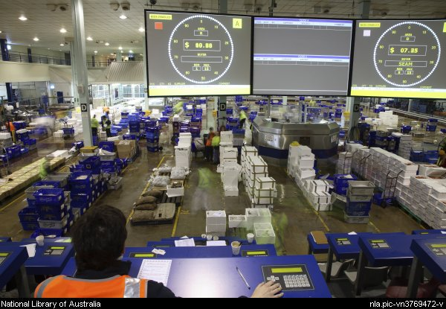
3. Auction
What if there are N>=2 suppliers available? Let them compete in an auction.
There are many auction formats:
English Auction
Dutch Auction
Sealed-Bid-Second-Price Auction (Vickery Auction)
Assume that the highest cost to complete the outsourced project activity is c_{U}.
Auction clock in Sydney fish market
Notes:
Sydney fish market auction clock.

Slide 58
3. Auction
The buyer announces a fixed price contract that pays p=c_{U} to the winner. However, the N suppliers must compete for the right to execute this contract. The supplier who bids the highest upfront fee to the buyer wins the contract and pays the second highest upfront fee (or the upfront fee is deducted from the final payment made by the buyer to the winning supplier).
Example: A buyer announces a fixed price contract that pays the supplier $900,000 for constructing a new house. Each supplier bids an upfront fee. This upfront fee is paid to the buyer or is deducted from the final payment from the buyer to the supplier. Whoever bids the highest upfront fee wins the contract, but pays the second highest upfront fee.
Vickrey, William (1961). "Counterspeculation, Auctions, and Competitive Sealed Tenders". The Journal of Finance. 16 (1): 8–37.
Notes:
Reverse auction where a buyer asks suppliers to bid; auction where many buyers bid for the good.

Slide 59
3.1 Auction FP contracts
Use the Vickery’s auction (the second highest-bid auction).
Vickery (1961) proved that the equilibrium strategy for each supplier is to bid their true value.
Supplier ID | Private true cost | True Value | Bid
1 | $600,000 | $300,000 | $300,000
2 | $700,000 | $200,000 | $200,000
3 | $650,000 | $250,000 | $250,000
4 | $710,000 | $190,000 | $190,000
The winner is supplier 1 who pays $250,000 upfront fee to the buyer. The buyer’s actual cost is $900,000-$250,000=$65000.

Slide 60
3.1 Auction FP contracts
When auctioning FP contract is suitable to use:
The scope of the project activity is simple to specify,
A large number of suppliers that participate in bidding,
Disadvantage is that the upfront fee puts pressure on the cash flow of suppliers.

Slide 61
3.2 Multi-attribute Auction
In reality, buyers concern about various attributes: cost, delivery performance, and capacity.
It requires the buyer to determine a scoring rule on these attributes or announce an object for the suppliers to bid.
The suppliers also possess multi-dimensional private information. The exact mechanism is difficult to solve.
Heuristics include the weighted score method with weights aligned with organisational needs.
For example, Score = w1 ∙ Cost + w2 ∙ Time +w3 ∙ Quality + … , which is remarkably similar to the scoring rule for project selection.

Slide 62
3.3 Double Auction
Consider a one-buyer-one-seller model. The buyer bids a price B to buy the good whereas the seller bids a price S to sell the good. If B≥S, a trade occurs and the good is changed hand at a settlement price (B+S)/2. If B<S, no trade occurs.
Reference:
Chatterjee, K., and W. Samuelson. (1983). “Bargaining under Incomplete Information.” Operations Research, 31, 835-51.

Slide 63
4. Contract Management Process
Planning purchases and acquisitions
Planning contracting
Requesting seller responses
Selecting sellers
Administering the contract
Closing the contract

Slide 64
Contract from lawyer’s perspective
A formal agreement between two parties wherein the contractor obligates itself to perform a service and the client obligates itself to do something in return.
Defines the responsibilities of the parties, spells out the conditions of its operations.
Defines rights of the parties to each other.
Grants remedies to a party if the other party breaches its transactional obligations.

Slide 65
A Portfolio Management System
Design of a supplier portfolio system:
Classification of suppliers
Strategic / non-strategic suppliers
Selection criteria depending upon classification
Evaluating suppliers
Managing the portfolio of suppliers.

Slide 66
Economist’s View on Outsourcing
Oliver E. Williamson, the shared recipient of 2009 Nobel Prize in Economic Sciences, is the pioneer of transaction-cost economics. He offered the following insights on outsourcing.
On make-or-buy decision, he argued that, “the ‘make’ decision, which, as viewed from the TCE perspectives, is viewed as the organization form last resort.”
On the governance structure of transactions, he argued that, “the ease of contracting varies with the attributes of the transaction, with special emphasis on whether preserving continuity between a particular buyer-seller pair is the source of added value.”
“Asset specificity, uncertainty, and frequency of transactions give rise to bilateral dependency.”

Slide 67
Economist’s View on Outsourcing
Inefficiencies in buyer-seller relationship:
Unprogrammed adaptation. Ex ante contracts are incomplete.
Lock-in: Fundamental transformation, e.g., reduced number of suppliers or difficulties in finding a supplier with short notice.
Haggling: Inefficient ex post bargaining because ex post contracts are incomplete.
References:
Williamson, O. E. 1971. The vertical integration of production: Market failure considerations. American Economic Review, 61, 112-123.
Williamson, O. E. 2008. Outsourcing: Transaction cost economics and supply chain management. Journal of Supply Chain Management, 44, 5-16.

Slide 68
Outsourcing
A real-life example to illustrate Williamson’s views on outsourcing
You just landed at the airport in an unfamiliar country late on night. You found a taxi driver who said that he was willing to take you to your hotel for A$20. It’s a reasonable rate, but then the driver stopped the car once you left the airport. You were in the middle of nowhere—no streetlights—and there were no other cars on the road. The driver informed you that he couldn’t possibly take you to the town for only A$20—but for A$30, paid now, he would be more than happy to.
Is this circumstance a hold-up, according to Williamson’s views?
What do you do?
Pay A$30 immediately.
Get out and find another ride.
Pretend to agree to pay A$30 but when you get to the hotel, pay only A$20 and explain that the driver acts unethically.

Slide 69
Outsourcing
A real-life example about avoiding being held up
An American buyer bought shampoos from a factory in an Asian country and re-sold them to various hotel chains operating in USA. Each shampoo needs a plastic bottle. The American buyer and the factory owner played the game of deception (cat and mouse) for several years.
Prior to August when the major shipment for Christmas departs, the American buyer talked the factory owner into believing that a large order would be placed for Christmas. To prepare for such a large order, it would make sense to pre-stock plastic bottles, which were pretty cheap but took long lead time to procure.
Once the factory owner pre-stocked the bottles, the American buyer changed the attitude in bargaining for other products. The large order for shampoo was not materialized and the factory owner (rather than the buyer) was held-up.

Slide 70
Economist’s View on Outsourcing
With outsourcing, firms can
Focus on core competency.
Increase flexibilities by using the supplier’s technical knowledge.
Effective contract management can achieve high level of supply chain efficiency and mitigate “silo” behaviors.
Supply chain contracting is not an exact science.
Abuses of supply chain contracts are repeatedly exposed in the news media.
Effective negotiation is important.

Slide 71
Economist’s View on Outsourcing
Who should own the property right and determine the contract parameters?
Grossman and Hart (1986) argue that there is symmetry of control:
When residual rights are purchased by 1 party, they are lost by a 2nd party, and this leads to distortions
Opportunistic and distortionary behaviors are not removed, only shifted from one party to another party.
References:
Sanford J. Grossman and Oliver Hart, 1986, The Costs and Benefits of Ownership: A Theory of Vertical and Lateral Integration, Journal of Political Economy, 691-719.
Oliver Hart and John Moore, 1990, Property Rights and the Nature of the Firm, Journal of Political Economy, Vol. 98, No. 6, pp. 1119-1158.

Slide 72
Economist’s View on Outsourcing
The following tradeoffs emerged:
When is firm 1 control desirable?
When firm 1’s ex ante investment is more important than firm 2’s, and when over-investment by firm 1 is less severe problem than under-investment by firm 1
When is firm 2 control desirable?
When same conditions above are satisfied for firm 2
When is non-integration desirable?
When firm 1 and firm 2 investments are equally important (preferable for both to be at a medium level)
Main result: Optimal ownership structure is chosen to minimize overall loss in surplus that is due to investment distortions

Slide 73
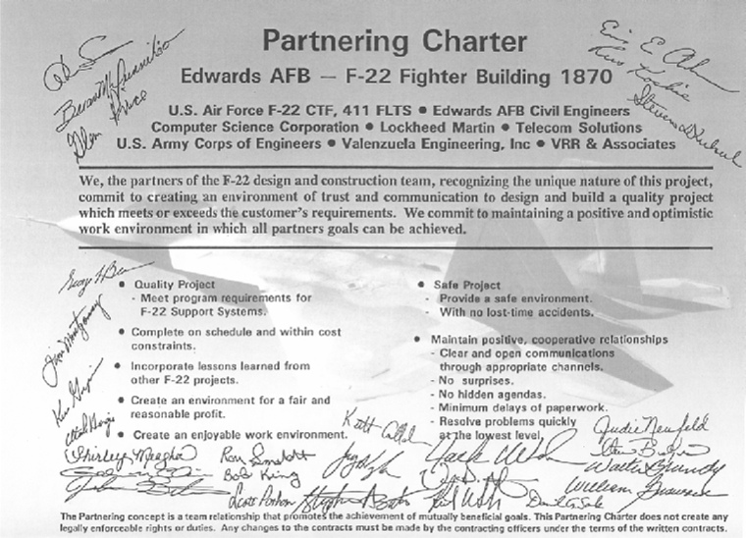
Project Partnering Charter
FIGURE 12.2

Slide 74
Questions?

